Slide 1

Object Oriented Programming
Creational Design Patterns: Abstract Factory
IT560
Sourish Dasgupta
Assistant Professor, DA-IICT, Gandhinagar
https://daiict.ac.in/faculty/sourish-dasgupta

Slide 2
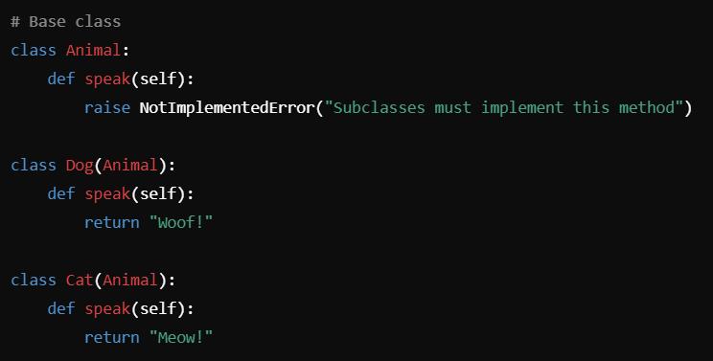
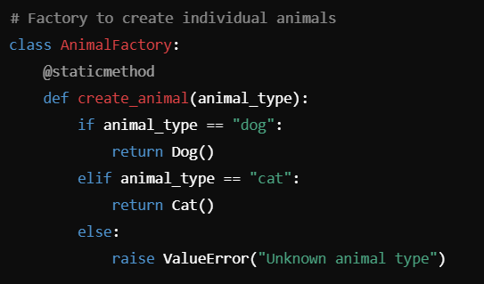
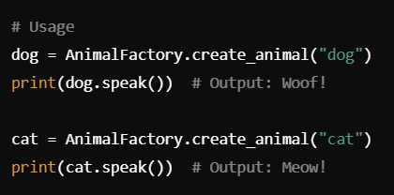
Relook at Factory Pattern
What’s missing??
Only create one type of object (e.g., a single hierarchy of animals)
Doesn’t enforce consistency between related objects (e.g., "domestic" or "wild" versions of both Dog and Cat)
IT560: Creational Design Patterns: Abstract Factory
Sourish Dasgupta

Slide 3
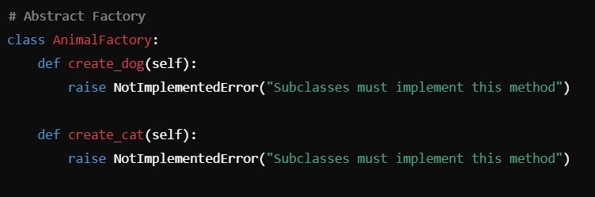
Abstract Factory Design Pattern
IT560: Creational Design Patterns: Abstract Factory
Sourish Dasgupta

Slide 4
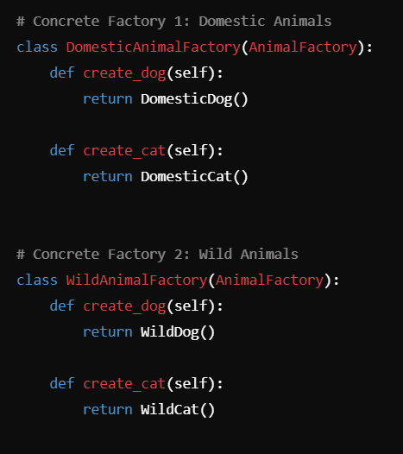
Creating Concrete Factories out of Abstract Factory
IT560: Creational Design Patterns: Abstract Factory
Sourish Dasgupta

Slide 5
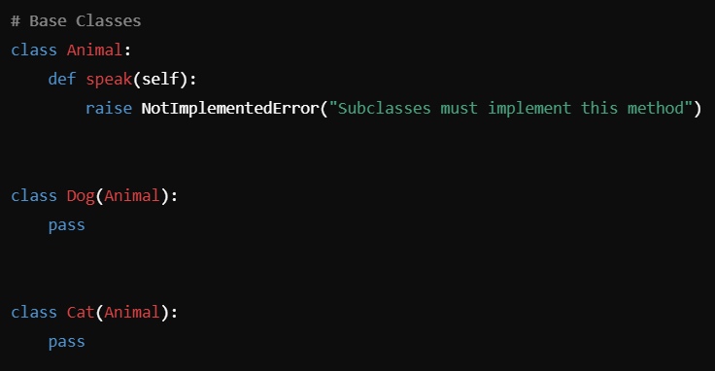
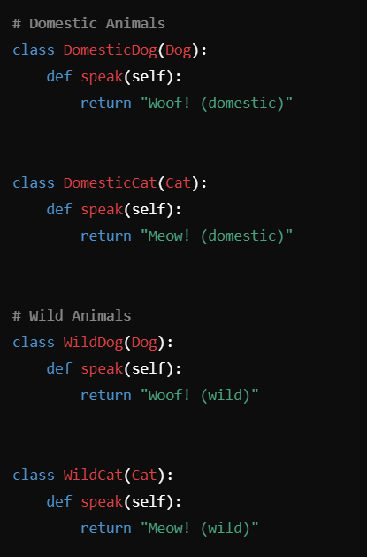
Creating the Classes
IT560: Creational Design Patterns: Abstract Factory
Sourish Dasgupta

Slide 6
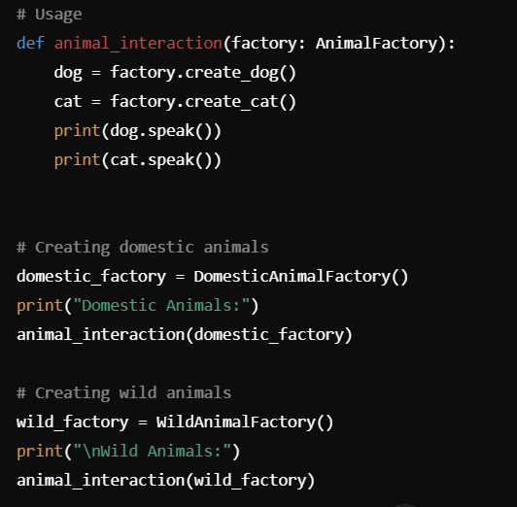
Creating Concrete Factories out of Abstract Factory
IT560: Creational Design Patterns: Abstract Factory
Sourish Dasgupta

Slide 7
Creating Concrete Factories out of Abstract Factory
Use Case | Factory Method | Abstract Factory
Single object creation | Works well | Overkill
Families of related objects (eg. Domestic Animal Family) | Cannot enforce consistency | Enforces consistency across object families
Need for multiple concrete factories | Harder to manage | Each concrete factory handles one family easily
Example | Create a Dog or Cat | Create a DomesticDog and DomesticCat pair
IT560: Creational Design Patterns: Abstract Factory
Sourish Dasgupta

